Slide 1
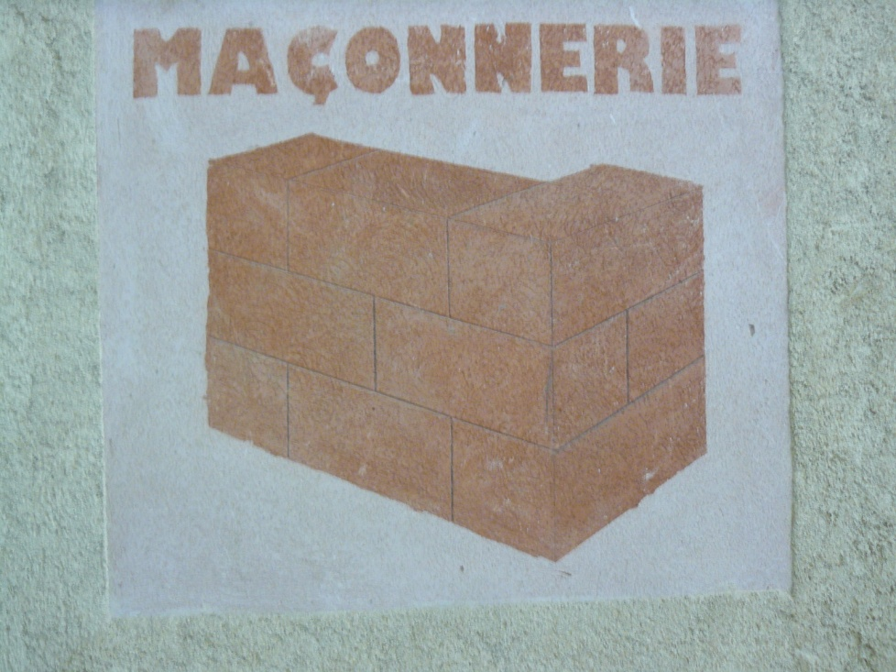
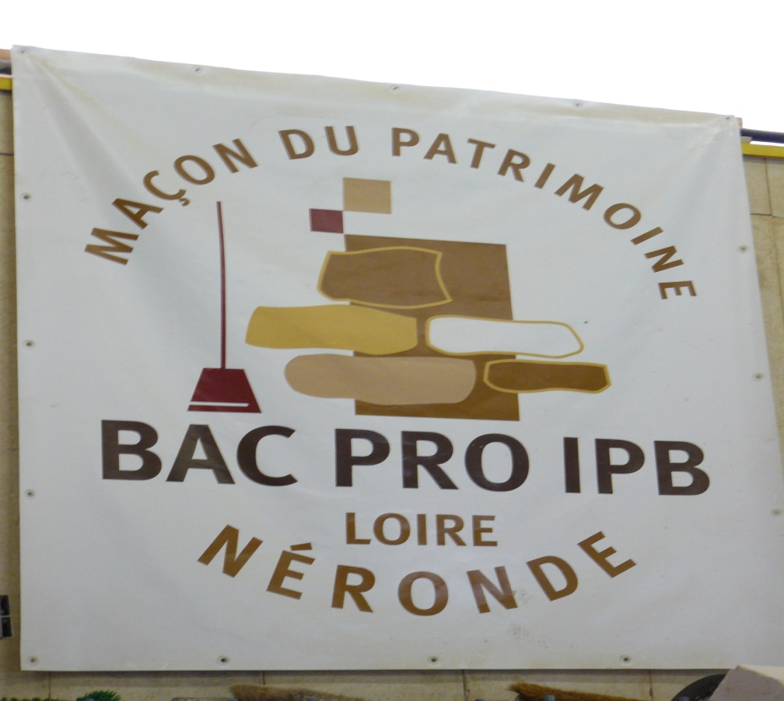
MASONRY / BAC PRO IBP

Slide 2
PRESENTATION OF THE COURSES
The school offers several courses:
CAP masonry (vocational training certificate) in 2 years with 14 weeks of traineeship.
And a A’ Level IPB (work on old buildings) in 2 years; 3 weeks studying at school, 3 weeks working in companies, in turns.

Slide 3
IPB WORKSHOP

Slide 4
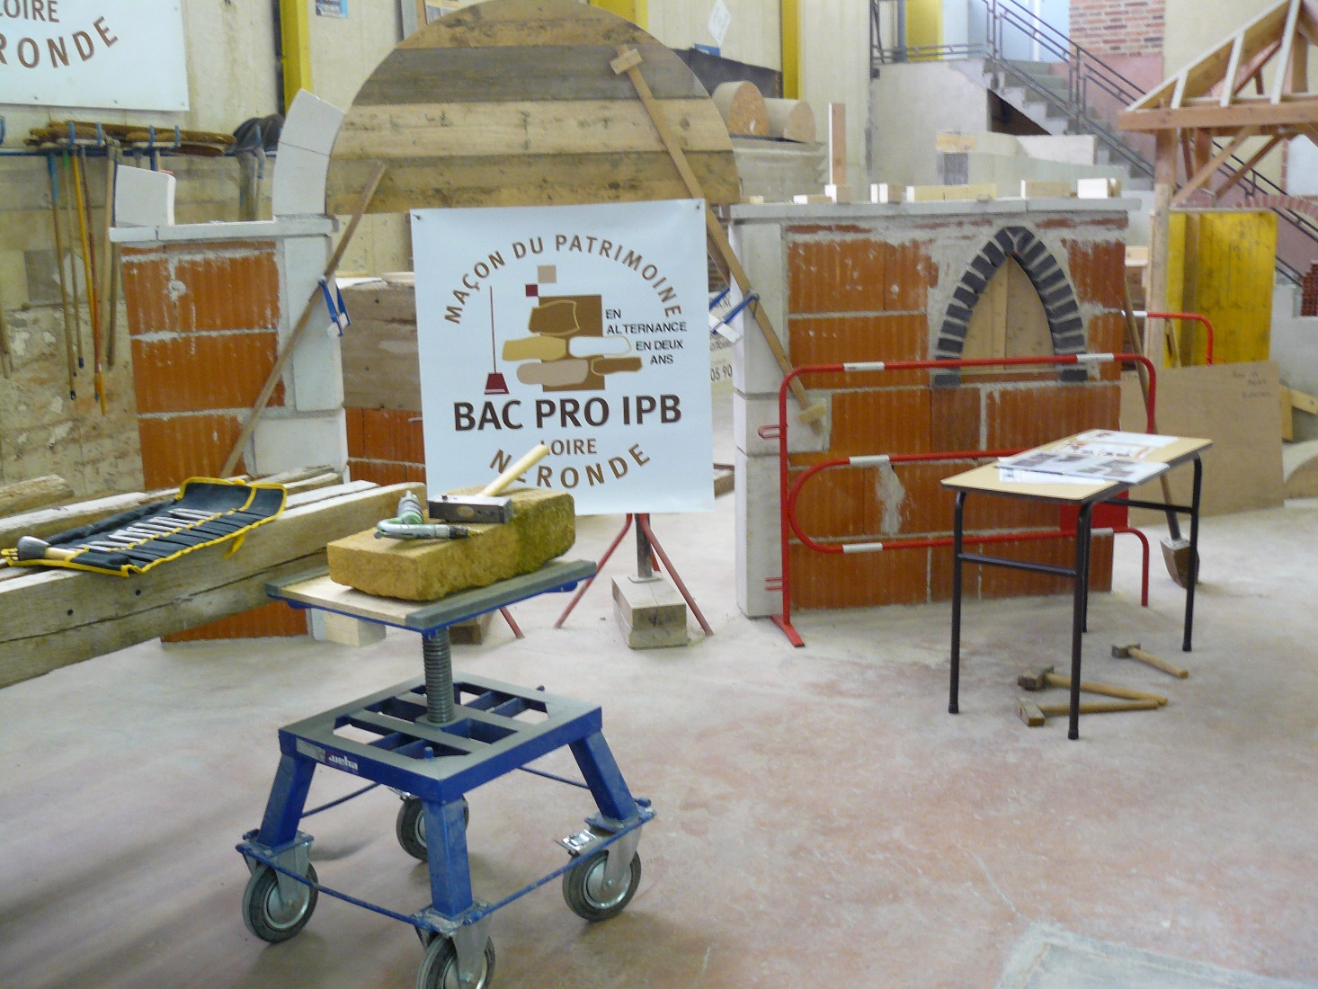

Slide 5
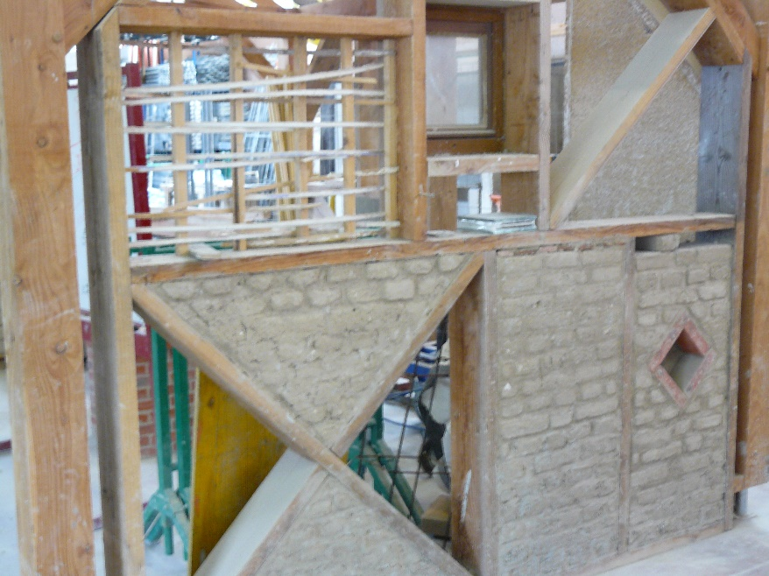
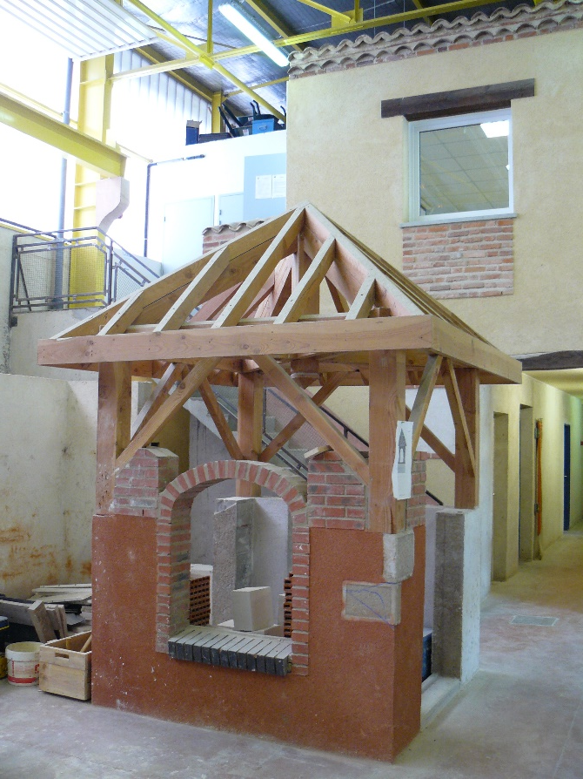
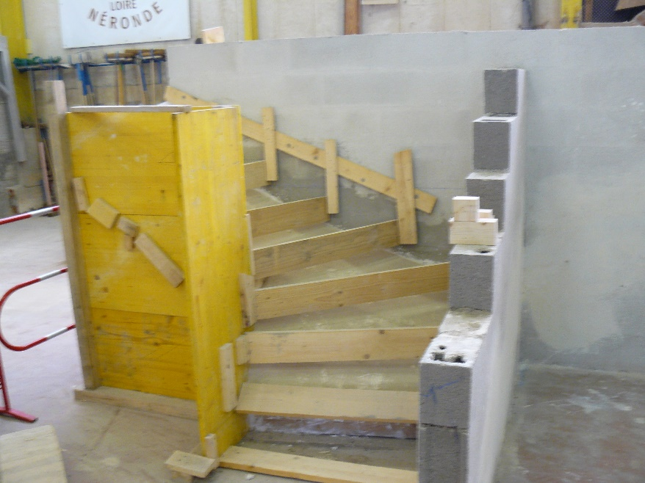

Slide 6
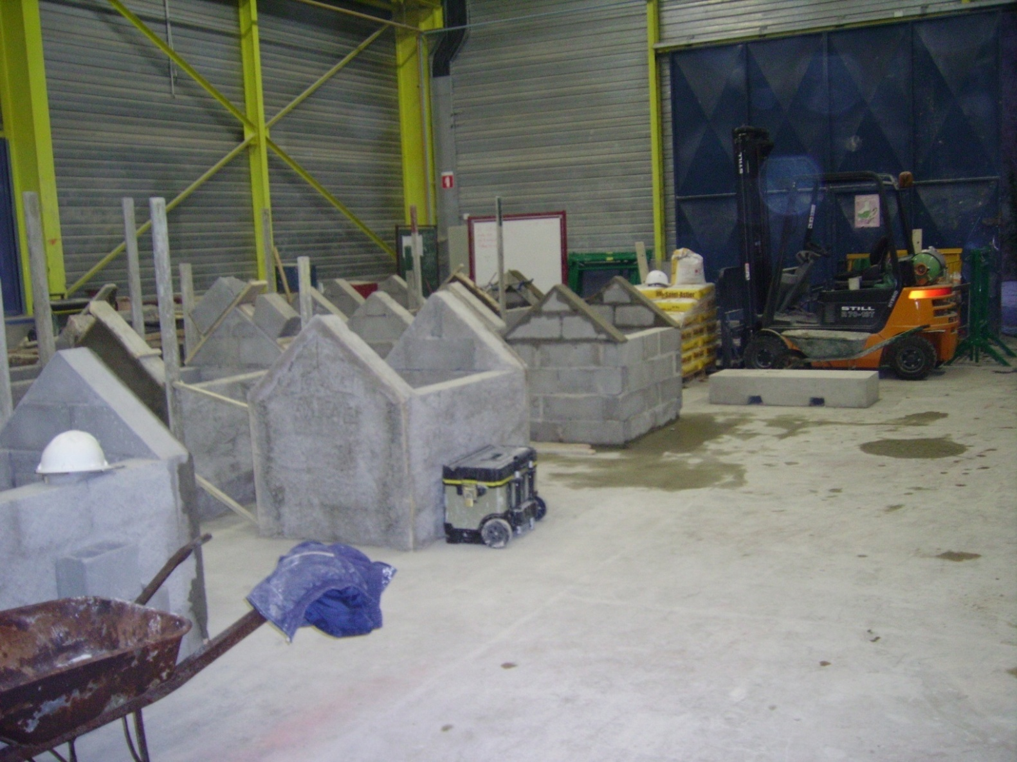
vocational training certificate WORKSHOP

Slide 7
