Slide 1
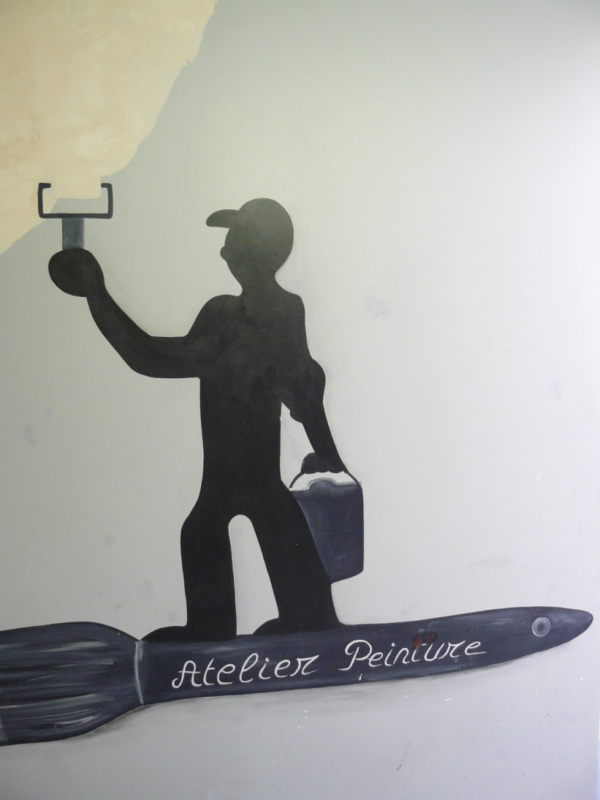
Painting section

Slide 2
The painting workshop

Slide 3
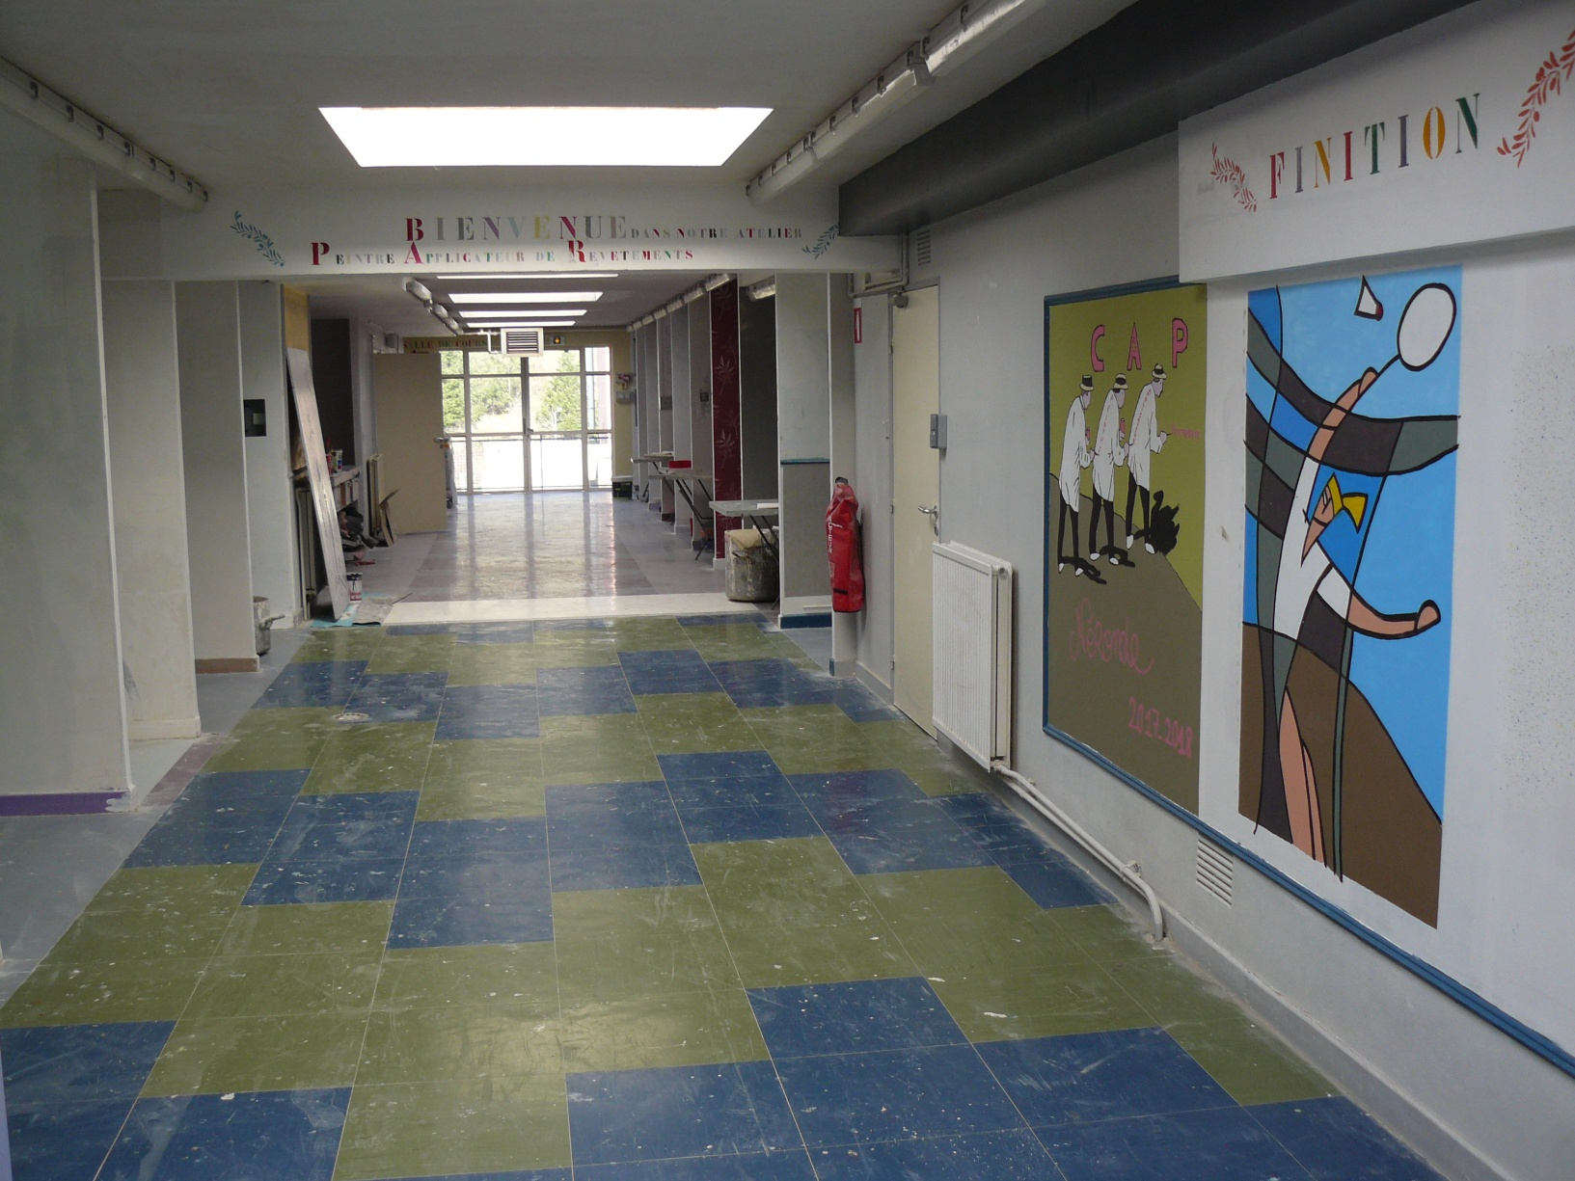
CAP diploma presentation
CAP means “Certificat d’Aptitude Professionnelle”, vocational training certificate.
During their CAP painting training, students do finishing work, paint application, ceiling and partition installation. They have 12 weeks of internship in business during their 2-year course.

Slide 4
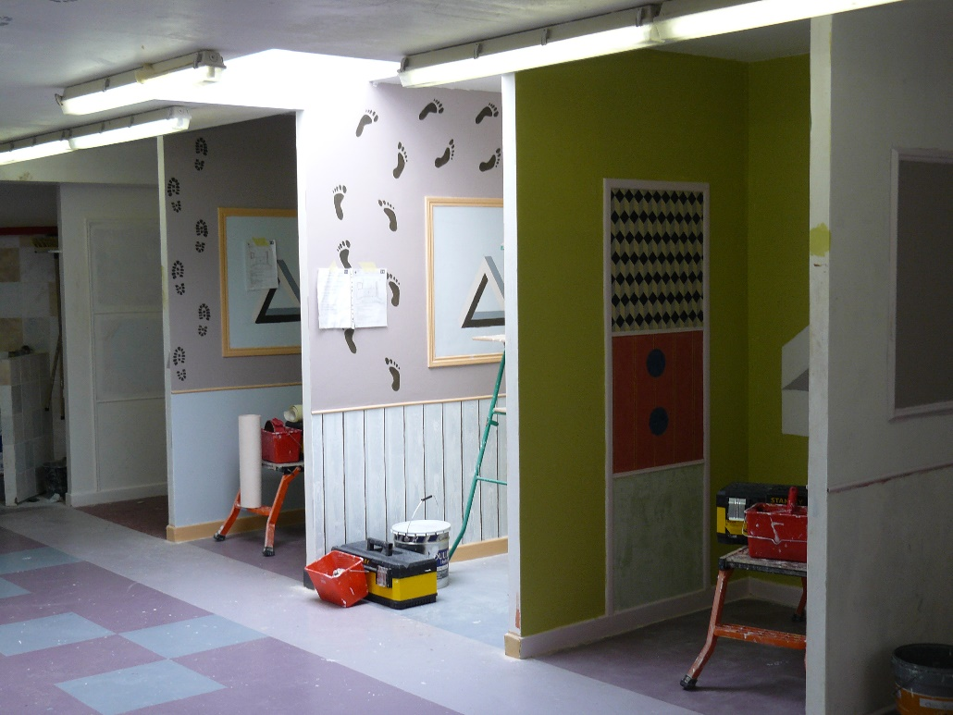
1st year class cabins

Slide 5
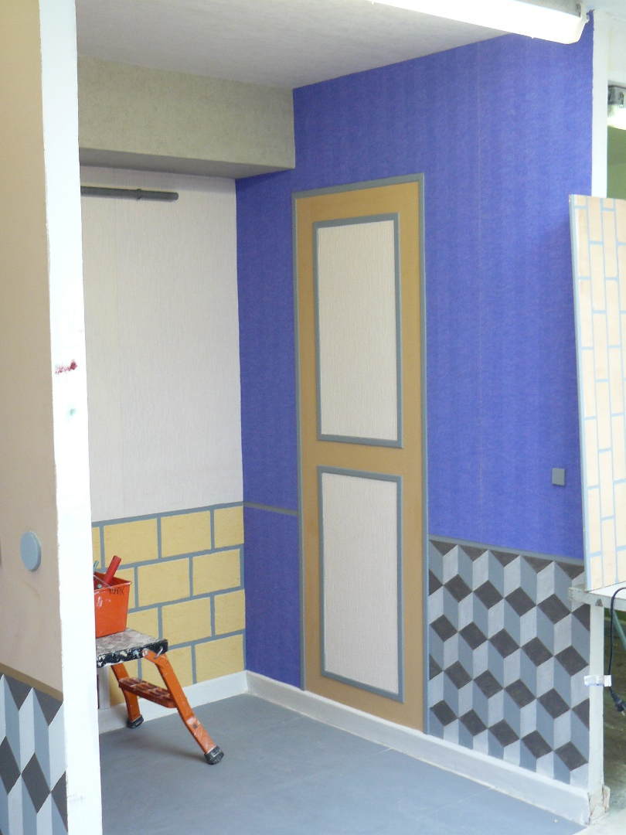
CAP terminal class cabins

